Slide 1


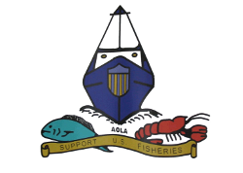

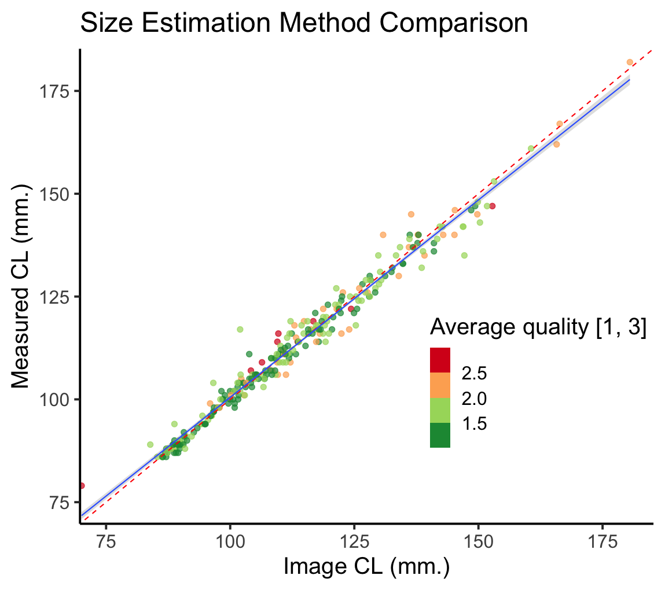
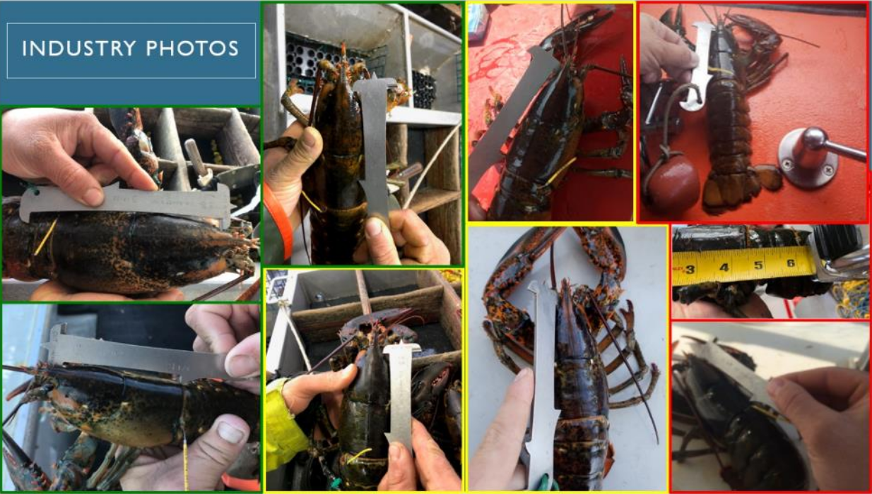
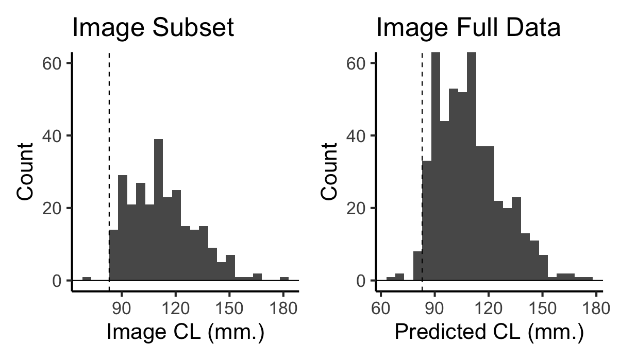
Building confidence: Developing a method to reduce barriers to entry and incorporate fishermen in data collection
Everett Rzeszowski¹, Damian C. Brady¹, Kathleen Reardon², Heidi Henninger³, and Joshua T. Carloni⁴
¹Darling Marine Center, ²ME Dept. Marine Resources, ³Northeast Fishery Science Center, ⁴NH Fish and Game
Abstract
Results
The ASMFC’s American Lobster Stock Assessment requires estimates of molt increment and interval to parameterize the growth transition matrix (GTM) that models how lobsters of different sizes will grow and recruit into the fishery. Tagging studies are an effective method to collect this type of information, but industry buy-in can be challenging. Here, we released 17,704 tagged lobsters in the Gulf of Maine and Georges Bank regions 2015 - 2020 (Henninger et al. 2020). Harvesters were encouraged to submit images of recaptured lobsters with a standard lobster gauge as a scale to estimate carapace length (CL) using ImageJ. Images were analyzed to produce length records and each was assigned a quality score. Image-derived lengths were found to correlate well with measured observations, regardless of the overall image quality. Validating this image-based method of length estimation provided additional length records and increased the likelihood of harvesters contributing data with broad potential for citizen-science applications.
Results
Methods
To investigate connectivity and collect updated growth information for data poor lobster demographies i.e. large reproductive females, 17,704 lobsters were tagged and released in LCMA 1 and LCMA 3.
A subset of submitted recapture images with direct measurements and ImageJ length estimates were used to calibrate regression models, Obs. Length ~ Image Length and Obs. Length ~ Image Length + Image Quality.
The parsimonious model was selected and used to predict length estimates for an additional 251 images without direct measurements.
Industry Outreach
Figure 2: Scatterplot comparing image-derived CL and measured observations. Points are colored according to average quality from 1 to 3, where 1 is high quality and 3 is the lowest quality. A 1:1 line, representing a perfect fit, is drawn in dotted red. A regression line for the model Obs. Length ~ Image Length is added in blue with a gray standard error window.
The inclusion of image quality did not significantly affect the results of regression models. Both models describe observed length values well.
Figure 1: Example images with traffic light color grading, where a green border is given to a high-quality image, yellow is intermediate quality, and red is low quality.
The project partners requested industry submit images with recaptures for ImageJ length analysis.
This slide was presented at Maine Fishermen’s Forum 2019 to encourage high-quality image reporting.
Figure 3: Histogram displaying data availability across size classes for the subset of images with co-occurring length measurements (Left) and the predicted lengths from the full dataset of images (Right).
Significance
Due to the high fidelity between observed and modeled lengths, we were able to use the model in a predictive capacity and estimate length for images that were reported without length observations (n = 251).
Updating the GTM to maintain biologic relevancy under changing environmental regimes is an ASMFC research priority (ASMFC, 2015; Townsend et al. 2023).
Validating ImageJ as a method of length estimation expanded length records by a third, an analog effect to releasing 6,000 additional lobsters.
Image data reduces the unique materials required to participate in data collection and speeds up the time associated with each measurement.
Improved accessibility increases participants in fishery-engaged research (Johnson and van Densen, 2007).
This work has been submitted to the 2023 IWCL Special Edition of Fisheries Research.
Acknowledgements
References
This work could not have been completed without the participation of the offshore Gulf of Maine lobster fleets operating in LMA 1 and LMA 3. Fishermen allowed researchers to tag lobsters during their workday and have reported tags from 2015 – Present. Thanks to the tagging and image review technicians who have contributed to this dataset.
ASMFC. (2015). American States Marine Fisheries Commission, American Lobster Benchmark Stock Assessment and Peer Review Report.
Henninger, H., Carloni, J., & Reardon, K. (2020). Lobster Migration and Growth: Continuation and Expansion of 2015 Tagging Effort on Georges Bank and in the Gulf of Maine (NOAA SALTONSALL KENNEDY PROGRAM NOAA Grant Award # NA17NMF4270201; p. 27).
Johnson, T. R., & van Densen, W. L. T. (2007). Benefits and organization of cooperative research for fisheries management. ICES Journal of Marine Science, 64, 834–840. DOI: 10.1093/icesjms/fsm014
Townsend, D. W., Pettigrew, N. R., Thomas, M. A., & Moore, S. (2023). Warming Waters of the Gulf of Maine: The Role of Shelf, Slope and Gulf Stream Water Masses. Progress in Oceanography. DOI: 10.1016/j.pocean.2023.103030
This work is funded by:
ACCSP Award #NA15NMF4740253
NOAA SK Program Award #NA17NMF4270201
DOE DE-EE0009426
The University of Maine is an EEO/AA employer, and does not discriminate on the grounds of race, color, religion, sex, sexual orientation, transgender status, gender expression, national origin, citizenship status, age, disability, genetic information or veteran’s status in employment, education, and all other programs and activities. The following person has been designated to handle inquiries regarding non-discrimination policies: Director of Equal Opportunity, 101 North Stevens Hall, University of Maine, Orono, ME 04469-5754, 207.581.1226, TTY 711 (Maine Relay System).

